Slide 1
Speech Emotion Recognition Using Deep Learning:
→Sahith Reddy (2010040088)
→Raj Parikh (2010040076)
→Nanda Sai (2010040028)

Slide 2

Introduction:
Speech emotion recognition is an act of predicting human's emotion through their speech along with the accuracy of prediction. It creates a better human computer interaction.
There are various states to predict one's emotion, they are tone, pitch, expression, behavior etc.
Among them, few states are considered to find the emotion through the speech.
This research work considers the RAVDESS dataset (Ryerson Audio-Visual Database of Emotional Speech and Song dataset).
The RAVDESS consists of 24 professional actors, each performing 104 unique vocalizations with emotions that include: happy, sad, angry, fear, surprise, disgust, calm and neutral.

Slide 3
Objectives:
Speech input: Input to the system is speech taken from RAVDESS Dataset.
Feature extraction and selection: There are 8 emotional states of emotion and emotion relevance is used to select the extracted speech features. For speech feature extraction to selection corresponding to emotions all procedure revolves around the speech signal.
Classification: Finding a set of significant emotions for classification is the main concern in speech emotion recognition system. There are 8 emotional states contains in a typical set of emotions that makes classification a complicated task.
Recognized emotional output: happy, sad, angry, fear, surprise, disgust, calm and neutral.

Slide 4
Motivation:
Identifying the emotion expressed in a speech percept has several use cases in the modern-day applications. The field of Internet of Things (IoT) is rapidly growing. Many real word IoT applications that are used daily such as Amazon Alexa, Google Home, and Mycroft function on voice-based inputs.
The study in a recent article foresees that by 2022, about 12% of all IoT applications would fully function based on voice commands only. These voice interactions could be mono-directional or bi-directional, and in both cases, it is highly important to comprehend the speech signal.
Identifying the emotional state of the user comes with a great advantage in this applications like automated vehicles. Considering emergency situations in which the user may be unable to clearly provide a voice command, the emotion expressed through the user’s tone of voice can be used to turn on certain emergency features of the vehicle.
Other applications of using a speech emotion detection system can be found in lie detecting systems, criminal department analysis, and in humanoids.

Slide 5
Dataset for Speech Emotion:
In the field of affect detection, a very important role is played by suitable choice of speech database. Three databases are used for good emotion recognition the system as given below
Elicited emotional speech database: In this case emotional situation is created artificially by collecting data from the speaker
Actor based speech database: Trained and professional artists collect this type of speech dataset.
Natural speech database: Real world data is used to create this database
→ We have used RAVDESS DATASET which is an Actor based speech database that contains the voice of 24 professional actors.

Slide 6
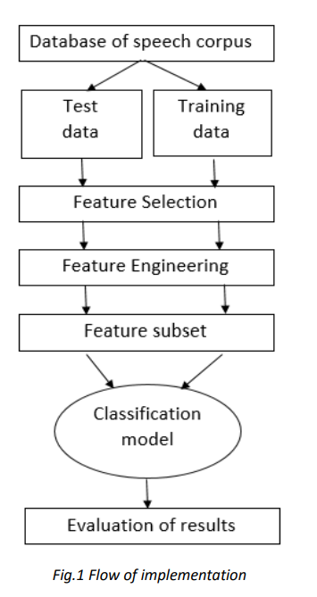
Methodology :-

Slide 7
Time-plan:
Collecting the required dataset.
Writing the code on testing and training the data.
Feature Extraction and preprocessing.
Building Classification Model.
Verifying the accuracy of the model output.

Slide 8
Work Done:
Collected the RAVDESS audio dataset from Kaggle
Chose Deep Learning algorithm to implement the emotion detection.
Done with 100% of code implementation
Tried to choose the best algorithm to get high accuracy as output.
Got an accuracy of 86.7% at the end.

Slide 9
Implementation :
The aim of the project is about the detection of the emotions elicited by the speaker while talking.
As an example, speech produced in a state of fear, anger, or joy becomes loud and fast, with a higher and wider range in pitch, whereas emotions such as sadness or tiredness generate slow and low-pitched speech.
Detection of human emotions through voice-pattern and speech-pattern analysis has many applications such as better assisting human-machine interactions.
We are presenting a classification model of emotion elicited by speeches based on deep neural networks MLP Classification based on acoustic features such as Mel Frequency Cepstral Coefficient (MFCC).
The model has been trained to classify eight different emotions (neutral, calm, happy, sad, angry, fearful, disgust, surprise).

Slide 10

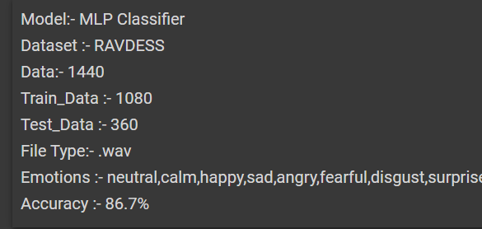

Slide 11
Result :
Our evaluation shows that the proposed approach yields accuracies of 87% MLP Classifier for 8 emotions using Ryerson Audio-Visual Database of Emotional Speech and Song (RAVDESS) dataset.
Code Link:-https://colab.research.google.com/drive/1SMUEHS9lF51o_vFX5CtDF-g02Ja6R5s6?usp=sharing

